Slide 1

TIC TAC TOE GAME
Shivam singh(Ra2011003010087)
Prakhar Kunwar Sinha(Ra2011003010093)

Slide 2
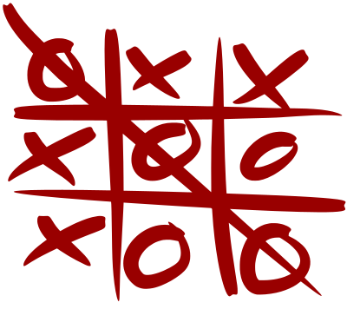
TIC TAC TOE GAME

Slide 3
CONTENTS
Max-Min algorithms
Analysis
Tic Tac Toe Using Min Max(implementation)
Code
Sample Output

Slide 4
Max-Min algorithms
Problem Statement
The Max-Min Problem in algorithm analysis is finding the maximum and minimum value in an array.
Solution
To find the maximum and minimum numbers in a given array numbers[] of size n, the following algorithm can be used. First we are representing the naive method and then we will present divide and conquer approach.

Slide 5
Analysis----
The number of comparisons can be reduced using the divide and conquer approach. Following is the technique.
Divide and Conquer Approach
In this approach, the array is divided into two halves. Then using recursive approach maximum and minimum numbers in each halves are found. Later, return the maximum of two maxima of each half and the minimum of two minima of each half.

Slide 6
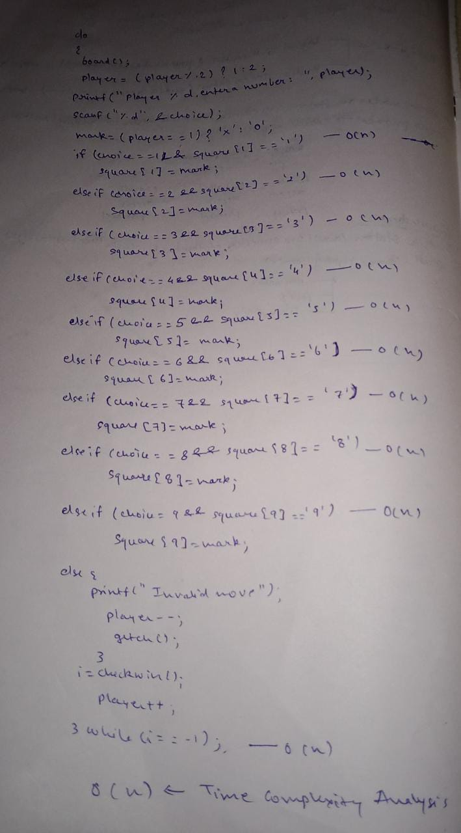
Analysis-------- of----------- code-----------

Slide 7
Tic Tac Toe Using Min Max--
Each state is denoted by the positions occupied by the letters of the two players in a 3x3 matrix and other empty places.
1. Initial State: An empty 3x3 matrix.
2. Intermediate State: Any arrangement of a 3x3 matrix obtained after applying valid rules on the current state.
3. Final State: Same letters in a complete row or complete column, or complete diagonal wins the game.
4. Rules: The players will get turns one after the other; they can mark their letters on the empty cell.

Slide 8


Slide 9
Tic-Tac-Toe is a two player game where each player uses a signature. The player who successfully places three respective signatures in a vertical, horizontal or diagonal row is the winner. Step 1: Use 3 X 3 matrix to get 9 cell tic tac toe board. Step 2: Signature 'X' is used for player 1 and 'Y' for player 2. And the players play alternatively.

Slide 10
Step 3: Get index as input from the players. And the index range is 1-9. i.e) from cell 1 to cell 9. Step 4: After each move, check whether that player has placed three respective signatures in vertical, horizontal or diagonal row. If yes, declare that particular player as winner. Step 5: If no, give chance for other player. Step 6: If all the cells in the Tic-Tac-Toe board got filled, then the game is drawn.

Slide 11
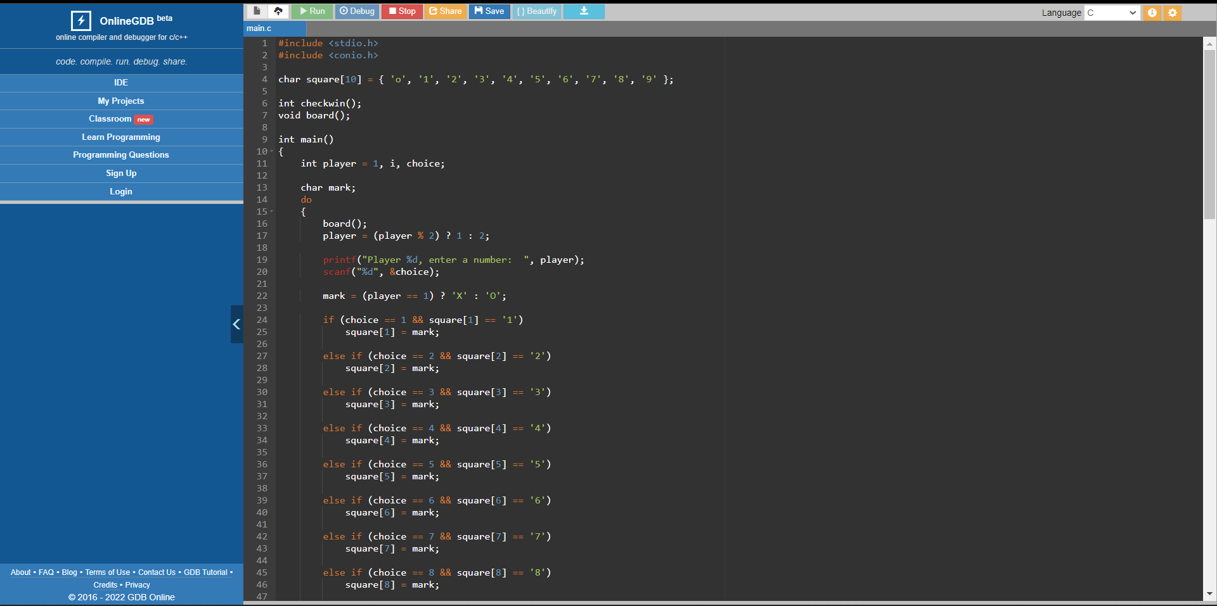
Code----

Slide 12
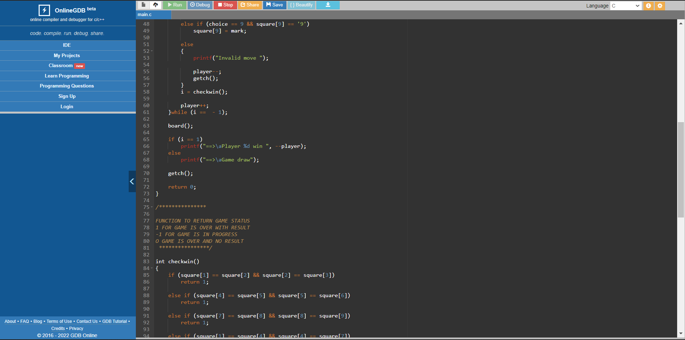

Slide 13
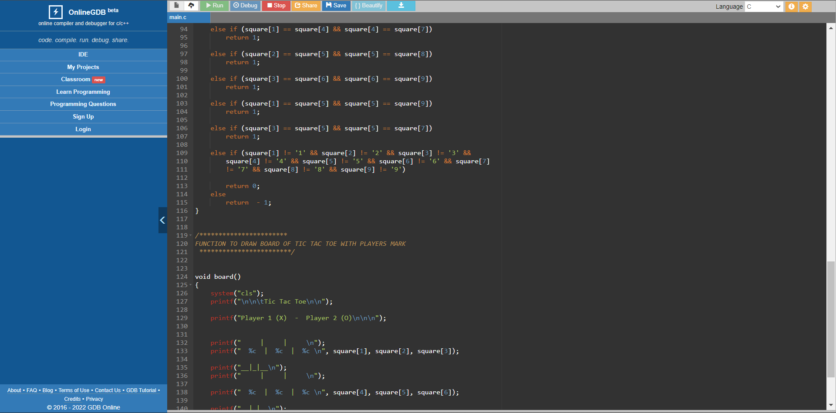

Slide 14
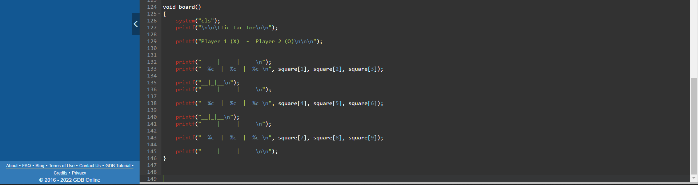

Slide 15
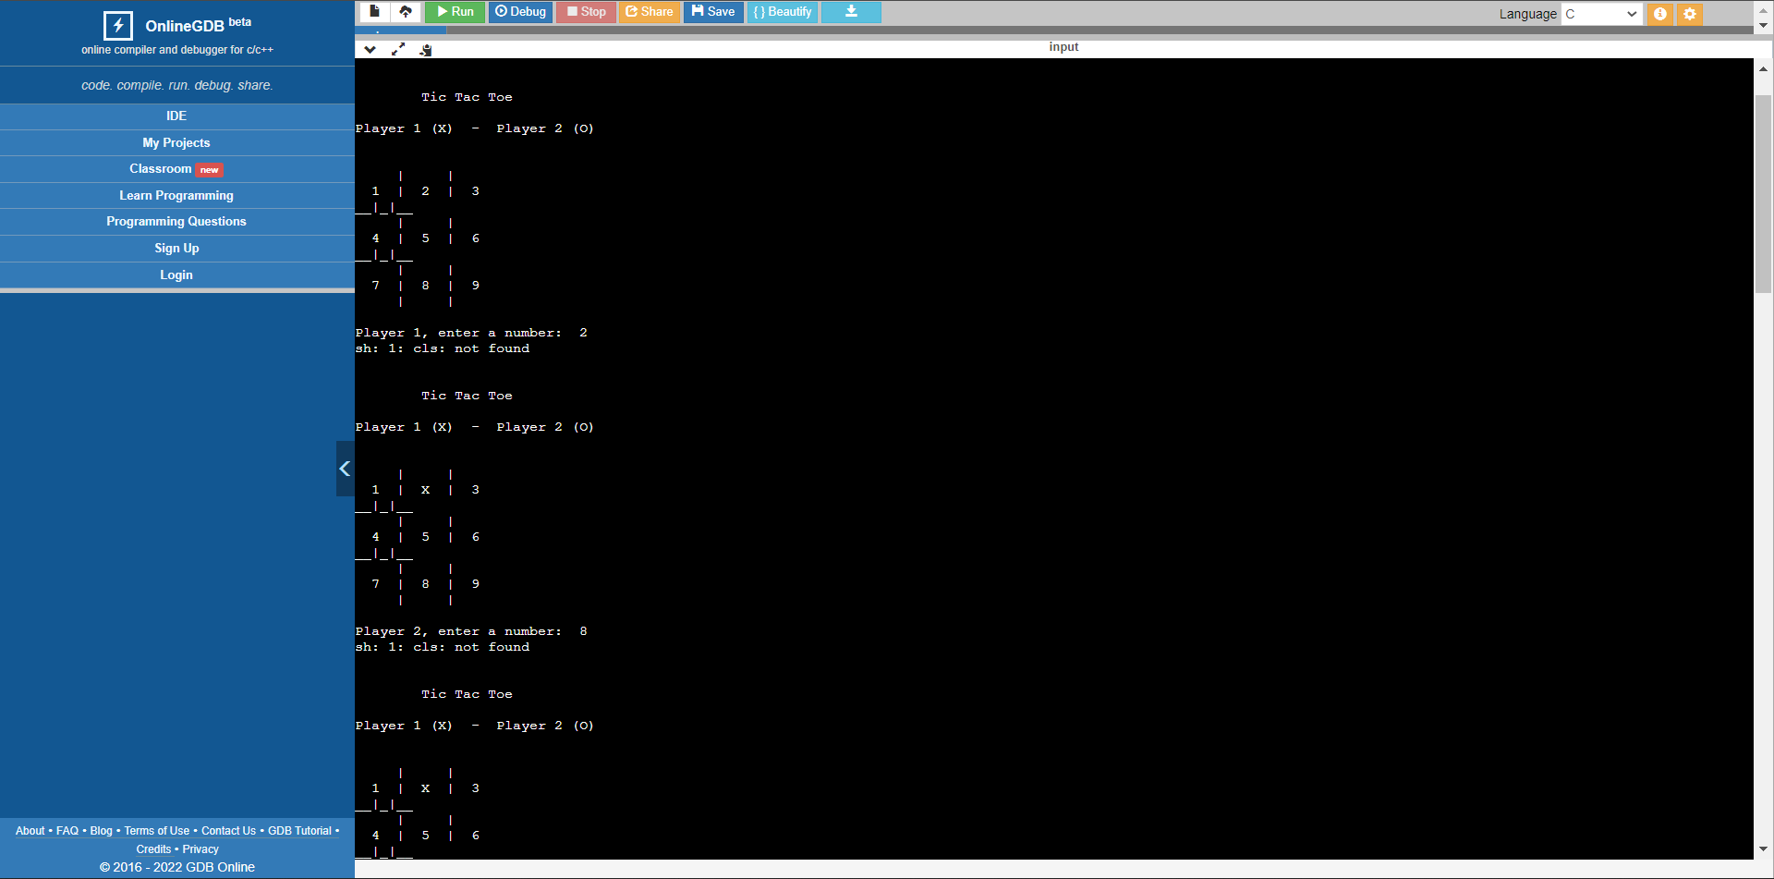
Output-----

Slide 16
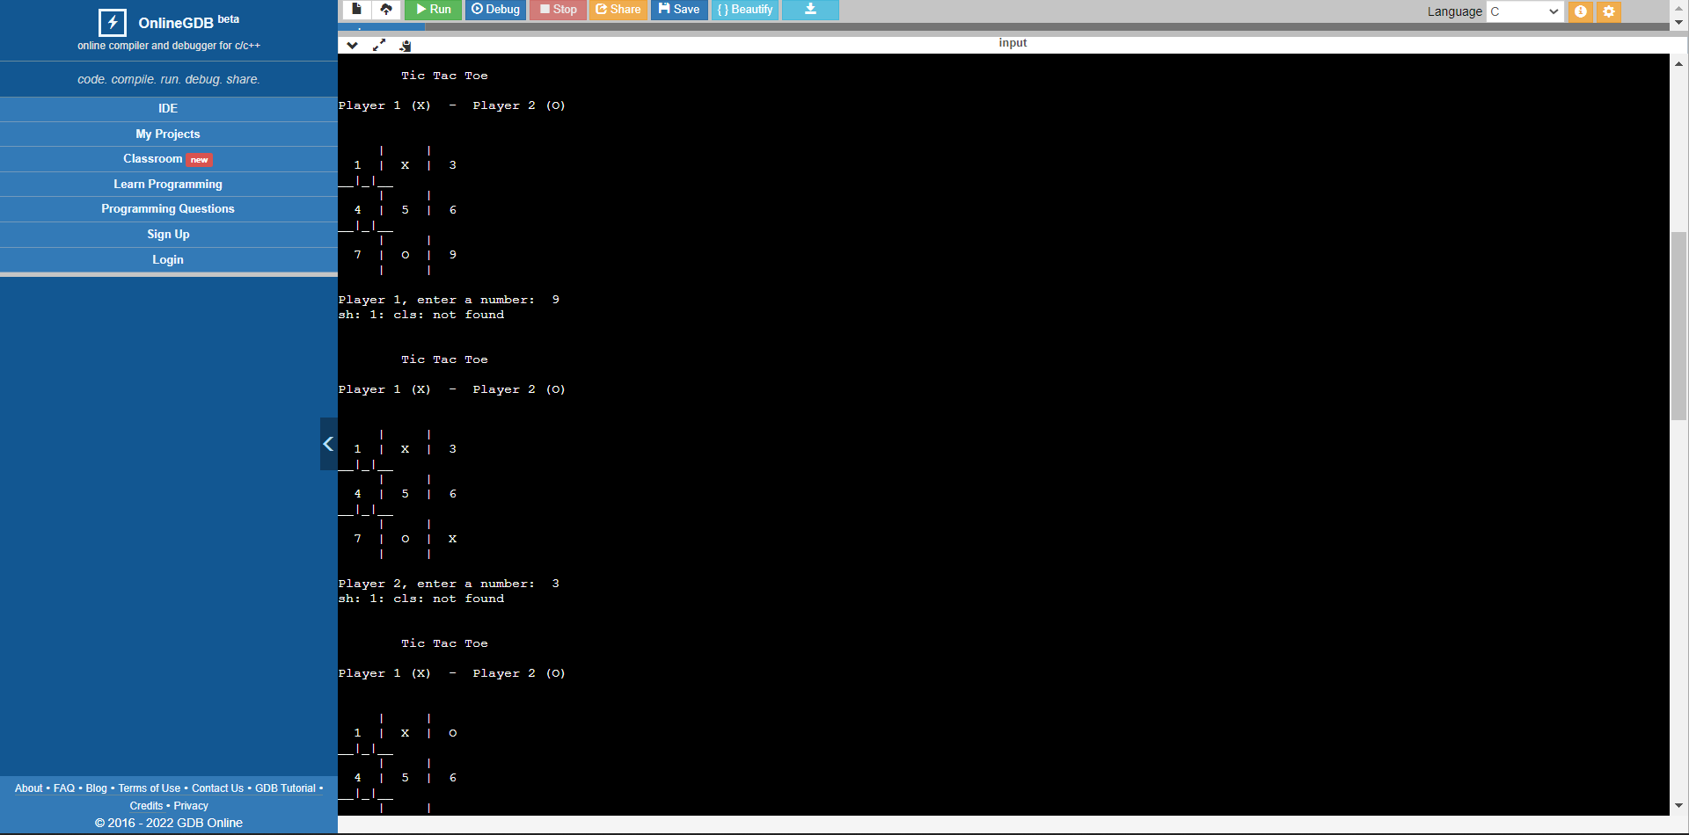

Slide 17
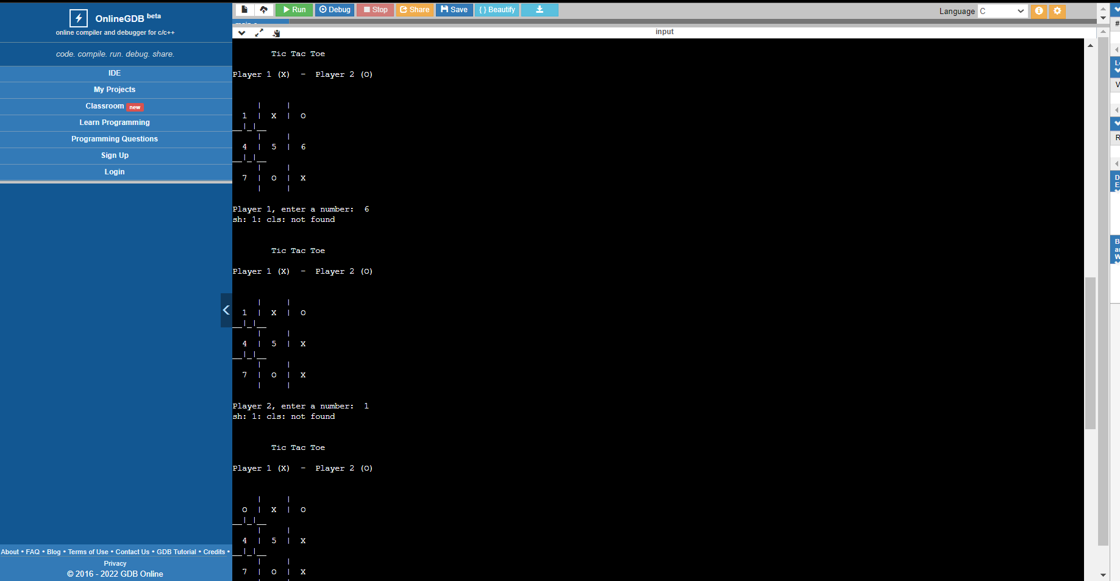

Slide 18
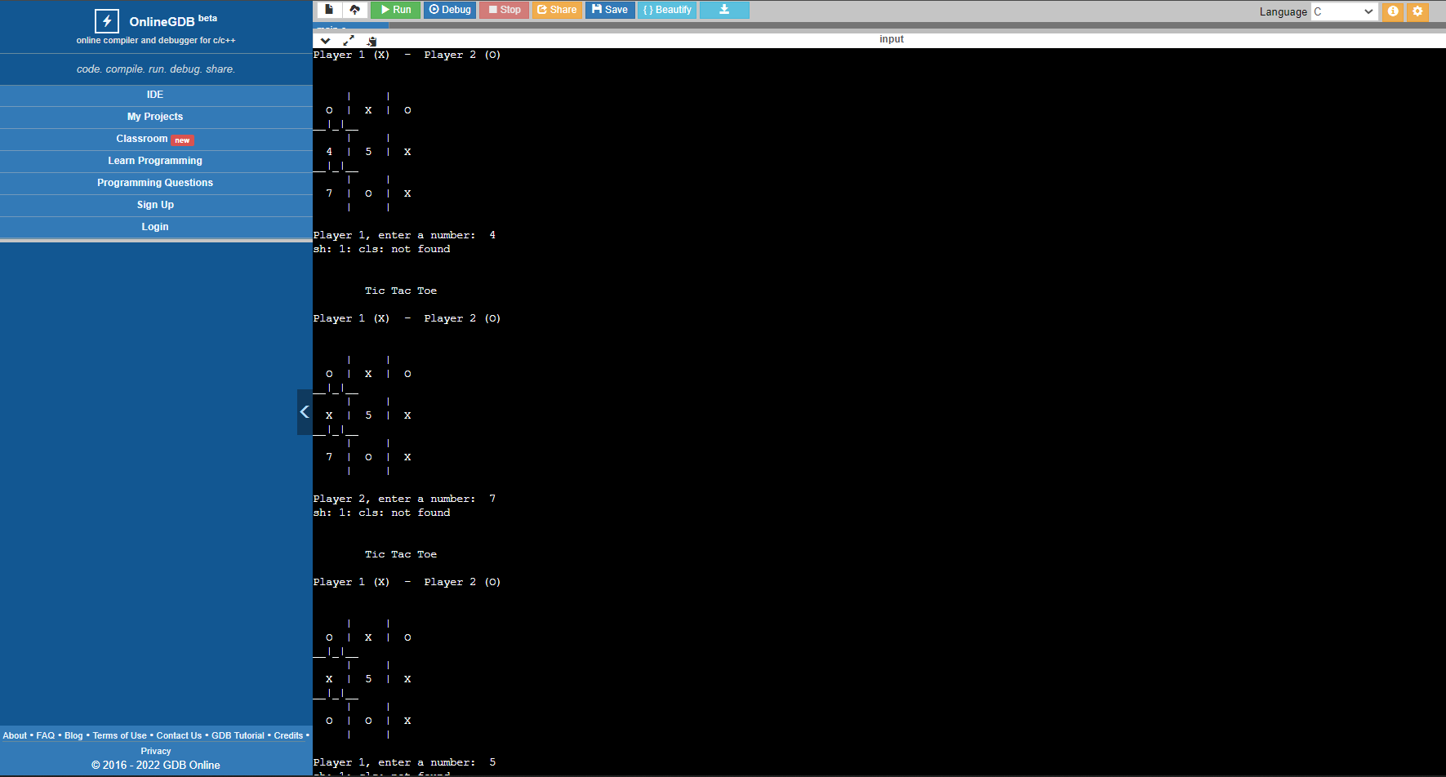

Slide 19


Slide 20
CONCLUSION
The Tic Tac Toe is a games for two players, called “X” and “O” , who take turns making the spaces in a 3x3 grid. The player who succeeded in placing three respective marks in a horizontal ,vertical, or diagonal row wins the game .We make Tic Tac Toe game successfully with the help of C language and it is very entertaining.Some of my friends also help me in understanding the concept of this tic tac toe game as I know also about the concept of this game from my childhood because I use to play with my friends.

Slide 21


